Slide 1
Tomlinson-Harashima Precoding in MIMO Systems:
A Unified Approach to Transceiver Optimization
Based on Multiplicative Schur-Convexity
Published by Alberto D’Amico

Slide 2
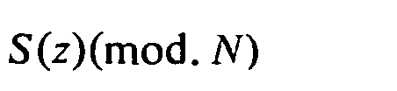

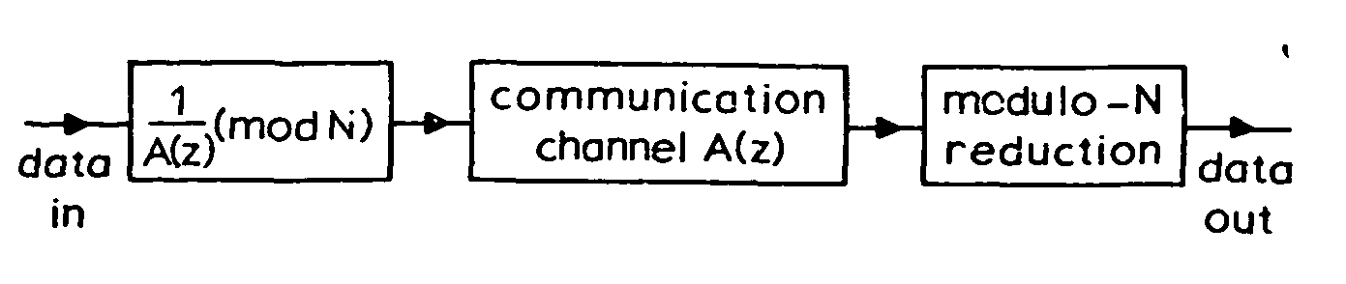



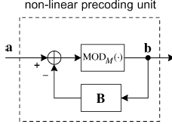
What is Tomlinson Harashima Precoding?
With matrices

Slide 3

Why do Transceiver Optimization?
Tx-Rx
Tx
Rx

Slide 4
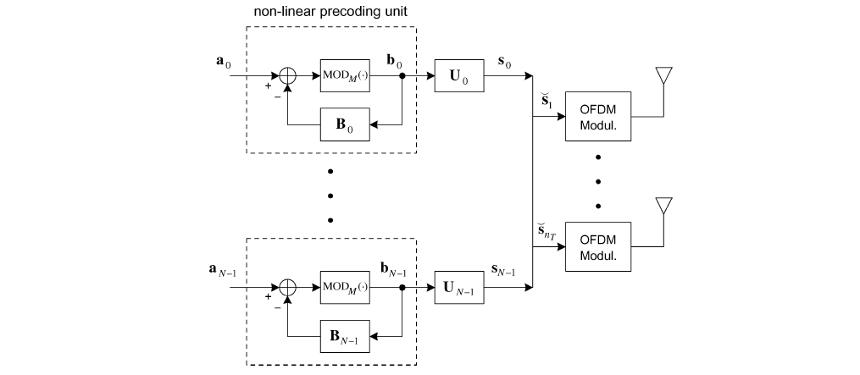
Non- Cooperative Scheme and Transmitter Structure
Bn is strictly lower triangular

Slide 5
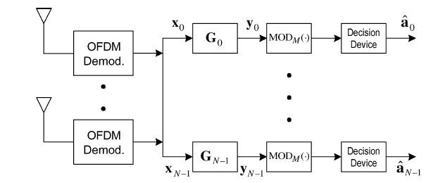
Receiver Structure

Slide 6
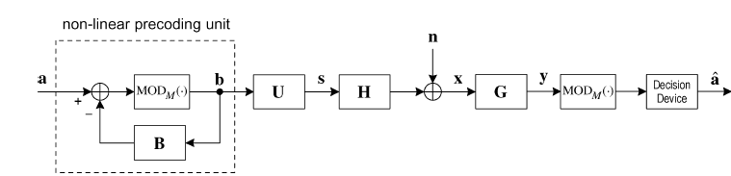
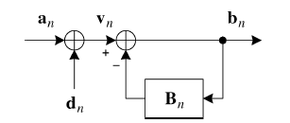
Signal Model
n
n
n
n
n
n

Slide 7

Optimization Problem and NC - OPA
Global Problem
s.t.
where
is the optimum solution to the below sub-problem
Sub - problem
s.t.

Slide 8
Optimization of Gn
H

Slide 9

Optimization of Cn
0
where

Slide 10
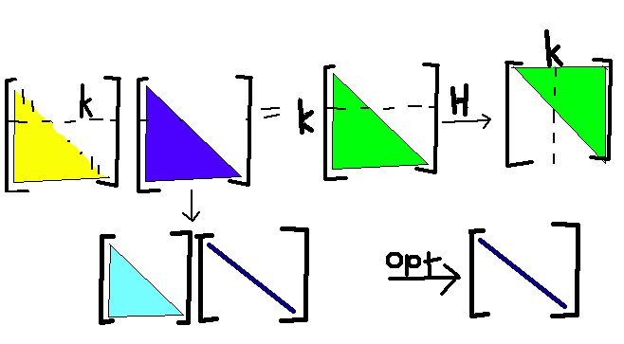
Idea of Optimum Cn

Slide 11
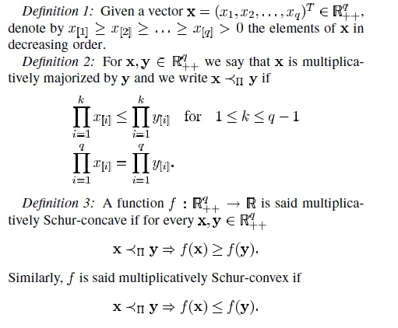
Multiplicative Schur functions

Slide 12


Optimization of Un for multiplicative Schur Concave
Let
Eg :
Where A is positive definite, R is positive semi-definite

Slide 13




Outline of Proof
Obtain the condition on X (find lower bound)
Obtain closed form of X using the condition
If the conditions on the left are true then you can find
By Weyl’s Theorem
Equality is achieved when A is diagonal or
is diagonal

Slide 14


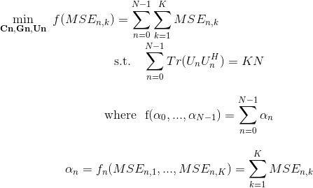


Optimization of Un for multiplicative Schur Convex
are the q largest eigen values of R
Eg: ARITH-MSE
F is an unitary matrix which makes all main diagonal elements of L equal

Slide 15



Outline of Proof
Obtain the condition on X (find lower bound)
Obtain closed form of X using the condition
If the conditions on the left are true then you can find

Slide 16
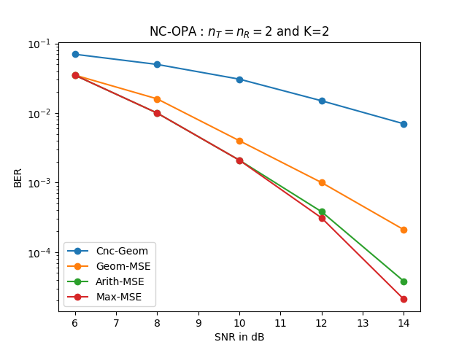
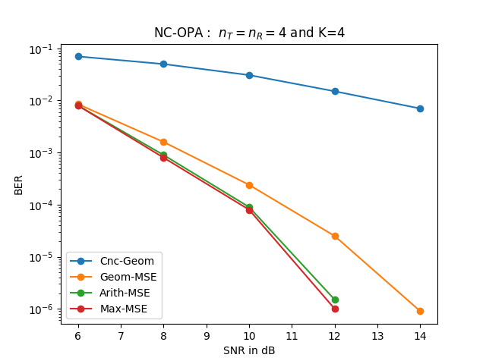
Simulation Results for NC-OPA

Slide 17
Carrier Cooperative Scheme
From a mathematical point of view, the multicarrier cooperative model is equivalent to the single-carrier model. It is a more general scheme that is devised allowing cooperation among subcarriers (carrier-cooperative approach, [9]).

Slide 18
Takeaways
THP is mainly used to remove interference
In NC-OPA you can independently process and optimize for each sub-carrier
Optimization of the Receive matrix is simply LMMSE estimation
Optimization of the precoding matrix is norm minimization
Optimization of Transmit matrix for Multiplicative Schur concave is aligning the vectors along the beam-forming directions (channel diagonalization)
Optimization of Transmit matrix for Multiplicative Schur convex boils down to the water-filling problem
Block processing of all carriers is done in carrier cooperative scheme, and its performance is better than Non-cooperative scheme

Slide 19
Thank You

